Slide 1
ECE-6612
http://www.csc.gatech.edu/copeland/jac/6612/
Prof. John A. Copeland
john.copeland@ece.gatech.edu
404 894-5177
Office: Klaus 3362
email or call for office visit
Safer Ways to Collect Web Objects
2/14/15

Slide 2
GET /BurstingPipe/adServer.bs?cn=int&iv=2&int=24585989~~45~~5282327~~
4405458058561701488^VsR~0~0~01020&usercookie=u2=e149274a-4664-4f90-8e0f-64158b582d71&rnd=0.6535025711898028&flv=-1&res=2 HTTP/1.1 {note encoded info in URL}
Accept: */*
Origin: http://www.msn.com
Accept-Language: en-US
Accept-Encoding: gzip, deflate
User-Agent: Mozilla/4.0 (compatible; MSIE 8.0; Windows NT 6.1; WOW64; Trident/4.0; SLCC2; .NET CLR 2.0.50727; .NET CLR 3.5.30729; .NET CLR 3.0.30729; Media Center PC 6.0)
Host: bs.serving-sys.com Connection: Keep-Alive Cache-Control: no-cache
HTTP/1.1 200 OK
Cache-Control: no-cache, no-store
Pragma: no-cache
Content-Length: 0
Content-Type: text/html
Expires: Sun, 05-Jun-2005 22:00:00 GMT
Set-Cookie: u2=e149274a-4664-4f90-8e0f-64158b582d7140q04g; expires=Fri, 06-Mar-2015 14:49:14 GMT; domain=.serving-sys.com; path=/
Set-Cookie: eyeblaster=FLV=-1&RES=2; expires=Fri, 06-Mar-2015 14:49:14 GMT; domain=bs.serving-sys.com; path=/
Access-Control-Allow-Credentials: true
Access-Control-Allow-Origin: http://www.msn.com
X-Powered-By: ASP.NET
P3P: CP="NOI DEVa OUR BUS UNI”
Date: Sat, 06 Dec 2014 19:49:13 GMT
Connection: close
from real Windows 7, IE 8
To 63.241.108.124 : 80
bs.serving-sys.com
Sizmek Technologies Inc.
NY, NY
“Sizmek is an open ad management stack. Sizmek helps marketers everywhere to manage, deliver and optimize digital campaigns across any screen.”
2

Slide 3
To www.csc.gatech.edu from real OS 10.10 Sea Monkey
GET /copeland/jac/6612/small.txt HTTP/1.1
Host: www.csc.gatech.edu
User-Agent: Mozilla/5.0 (Macintosh; Intel Mac OS X 10.10; rv:35.0) Gecko/20100101 Firefox/35.0 SeaMonkey/2.32.1
Accept: text/html,application/xhtml+xml,application/xml;q=0.9,*/*;q=0.8
Accept-Language: en-US,en;q=0.5
Accept-Encoding: gzip, deflate
Cookie: __utma=109337107.375395816.1359486088.1386178505.1392051695.35; _ga=GA1.2.375395816.1359486088
Connection: keep-alive
If-Modified-Since: Sat, 14 Feb 2015 16:34:32 GMT
If-None-Match: "f3c023-1b-50f0eed7e7600”
Cache-Control: max-age=0
HTTP/1.1 304 Not Modified
Date: Sat, 14 Feb 2015 16:43:36 GMT
Server: Apache
Connection: Keep-Alive
Keep-Alive: timeout=15, max=100
ETag: "f3c023-1b-50f0eed7e7600”
3

Slide 4
To www.csc.gatech.edu from real OS 10.10 Safari
GET /copeland/jac/6612/ HTTP/1.1
Host: www.csc.gatech.edu
Connection: keep-alive
If-None-Match: "f3c01b-1f79-50cc695276c40”
Accept: text/html,application/xhtml+xml,application/xml;q=0.9,*/*;q=0.8
X-Purpose: preview
User-Agent: Mozilla/5.0 (Macintosh; Intel Mac OS X 10_10_1) AppleWebKit/600.2.5 (KHTML, like Gecko) Version/8.0.2 Safari/600.2.5
Accept-Language: en-us
If-Modified-Since: Fri, 16 Jan 2015 15:25:29 GMT {last version of this file that is in cache}
Accept-Encoding: gzip, deflate
HTTP/1.1 200 OK
Date: Sat, 14 Feb 2015 16:44:18 GMT
Server: Apache
Last-Modified: Wed, 28 Jan 2015 16:06:26 GMT
ETag: "f3c01b-1fb3-50db88db2c480”
Accept-Ranges: bytes
Content-Length: 8115
Keep-Alive: timeout=15, max=100
Connection: Keep-Alive
Content-Type: text/html
4

Slide 5
To www.csc.gatech.edu from real OS 10.10 Chrome
GET /copeland/jac/6612/small.txt HTTP/1.1
Host: www.csc.gatech.edu
Connection: keep-alive
Accept: text/html,application/xhtml+xml,application/xml;q=0.9,image/webp,*/*;q=0.8
User-Agent: Mozilla/5.0 (Macintosh; Intel Mac OS X 10_10_1) AppleWebKit/537.36 (KHTML, like Gecko) Chrome/40.0.2214.111 Safari/537.36
Accept-Encoding: gzip, deflate, sdch
Accept-Language: en-US,en;q=0.8
HTTP/1.1 200 OK
Date: Sat, 14 Feb 2015 16:45:25 GMT
Server: Apache
Last-Modified: Sat, 14 Feb 2015 16:34:32 GMT
ETag: "f3c023-1b-50f0eed7e7600”
Accept-Ranges: bytes
Content-Length: 27
Keep-Alive: timeout=15, max=100
Connection: Keep-Alive
Content-Type: text/plain
5

Slide 6
To www.csc.gatech.edu (received “404”) from real OS 10.10 OS?
GET /apple-touch-icon-precomposed.png HTTP/1.1 {this file is unavailable}
Host: www.csc.gatech.edu
Accept: */*
Accept-Language: en-us
Connection: keep-alive
Accept-Encoding: gzip, deflate
User-Agent: com.apple.WebKit.WebContent/10600.2.5 CFNetwork/720.1.1 Darwin/14.0.0 (x86_64)
HTTP/1.1 404 Not Found
Date: Sat, 14 Feb 2015 16:44:20 GMT
Server: Apache
Last-Modified: Wed, 10 Sep 2014 18:09:57 GMT
ETag: "20f5598-8136-502b9f5a52740”
Accept-Ranges: bytes
Content-Length: 33078
Keep-Alive: timeout=15, max=100
Content-Type: text/html
<!DOCTYPE html>
<!--[if lt IE 9]><html class="lt-ie9" lang="en" dir="ltr"><![endif]-->
<!--[if IE 9]><html class="ie9" lang="en" dir="ltr"><![endif]-->
<!--[if (gt IE 9)|(gt IEMobile 7)|!(IE)]<!-->
<!--<![endif]-->
<head>
The extention “.png” would lead you to believe that this is going to get a simple image file in PNG format.
Actually the downloaded file is in HTML format, with “active” areas.
The file extension in the URL does not limit the type of file to be downloaded
6

Slide 7
To www.csc.gatech.edu from Mac, Chrome spoofing Android KitKat
GET /copeland/jac/6612/small.txt HTTP/1.1
Host: www.csc.gatech.edu
Connection: keep-alive
Pragma: no-cache
Cache-Control: no-cache
Accept: text/html,application/xhtml+xml,application/xml;q=0.9,image/webp,*/*;q=0.8
User-Agent: Mozilla/5.0 (Linux; Android 4.4.2; Nexus 4 Build/KOT49H) AppleWebKit/537.36 (KHTML, like Gecko) Chrome/34.0.1847.114 Mobile Safari/537.36
Accept-Encoding: gzip, deflate, sdch
Accept-Language: en-US,en;q=0.8
HTTP/1.1 200 OK
Date: Sun, 15 Feb 2015 14:45:59 GMT
Server: Apache
Last-Modified: Sat, 14 Feb 2015 16:34:32 GMT
ETag: "f3c023-1b-50f0eed7e7600”
Accept-Ranges: bytes
Content-Length: 27
Keep-Alive: timeout=15, max=100
Connection: Keep-Alive
Content-Type: text/plain
This is a small text file.
7

Slide 8
To www.csc.gatech.edu from Mac, Chrome spoofing MS IE8
GET /copeland/jac/6612/small.txt HTTP/1.1
Host: www.csc.gatech.edu
Connection: keep-alive
Accept: text/html,application/xhtml+xml,application/xml;q=0.9,image/webp,*/*;q=0.8
User-Agent: Mozilla/4.0 (compatible; MSIE 8.0; Windows NT 6.0; WOW64; Trident/4.0; SLCC1)
Accept-Encoding: gzip, deflate, sdch
Accept-Language: en-US,en;q=0.8
If-None-Match: "f3c023-1b-50f0eed7e7600”
If-Modified-Since: Sat, 14 Feb 2015 16:34:32 GMT
HTTP/1.1 304 Not Modified
Date: Sun, 15 Feb 2015 14:45:29 GMT
Server: Apache
Connection: Keep-Alive
Keep-Alive: timeout=15, max=100
ETag: "f3c023-1b-50f0eed7e7600”
8

Slide 9
from real Windows 7
GET /ajax/jQuery/jquery-1.8.3.min.js HTTP/1.1
Accept: */*
Referer: http://windows.microsoft.com/en-us/internet-explorer/ie-8-welcome
Accept-Language: en-US
User-Agent: Mozilla/4.0 (compatible; MSIE 8.0; Windows NT 6.1; WOW64; Trident/4.0; SLCC2; .NET CLR 2.0.50727; .NET CLR 3.5.30729; .NET CLR 3.0.30729; Media Center PC 6.0)
Accept-Encoding: gzip, deflate
Host: ajax.aspnetcdn.com
Connection: Keep-Alive
HTTP/1.1 200 OK
Content-Encoding: gzip
Accept-Ranges: bytes
Cache-Control: public,max-age=31536000
Content-Type: application/x-javascript
Date: Sat, 06 Dec 2014 19:49:14 GM
Etag: "016b0d4bac1cd1:0”
Last-Modified: Tue, 13 Nov 2012 16:20:44 GMT
P3P: CP="ALL IND DSP COR ADM CONo CUR CUSo IVAo IVDo PSA PSD TAI TELo OUR SAMo CNT COM INT NAV ONL PHY PRE PUR UNI”
Server: ECAcc (atl/FCCA)
Vary: Accept-Encoding
VTag: 43818332000000000
X-Cache: HIT X-Powered-By: ASP.NET X-Powered-By: ARR/2.5
Content-Length: 42638
. . .
9

Slide 10
Disguise Your IP Address
Use a VPN.
TOR – Anonymous Network Browser
https://www.torproject.org/download/download.html.en
Set up an ssh tunnel through another host (if permitted).
VNC (Virtual Network Console) (Mac: “Screen Sharing”).
Videos on Personal Privacy
http://www.cbsnews.com/news/data-brokers-selling-personal-information-60-minutes/
10

Slide 11
Safer Way to Download Files: Use wget and curl*
> wget –P dir http://www.csc.gatech.edu/copeland/jac/small.txt
(the file "small.txt" will be put in the directory "dir")
GET /copeland/jac/small.txt HTTP/1.1
User-Agent: Wget/1.16.1 (darwin14.0.0) {still reveals the operating system}
. . .
> curl -A 'Mozilla/4.0 (compatible; MSIE 8.0; Windows NT 6.0; WOW64; Trident/4.0; SLCC1)' -H 'Accept: */*' -H '-If-Modified-Since:' -o file http://www.csc.gatech.edu/copeland/jac/6612/small.txt (single line)
GET /copeland/jac/6612/small.txt HTTP/1.1
User-Agent: 'Mozilla/4.0 (compatible; MSIE 8.0; Windows NT 6.0; WOW64;
Trident/4.0; SLCC1)
Host: www.csc.gatech.edu
Accept: */*
. . . No ' -If-Modified-Since:' {this ensures a download}
-A 'text' sets the “User-Agent” to "text"
-H 'X:text' sets any header “X:” to “text”
11

Slide 12
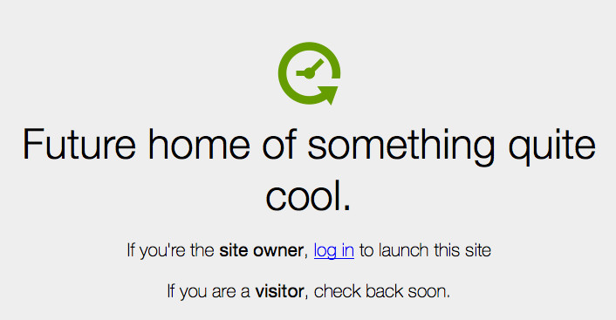
Scammer Site as Mac Using FireFox Browser Would See It
12

Slide 13
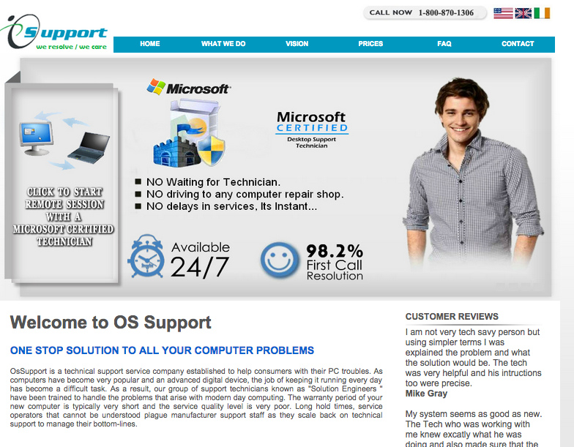
Scammer Site as PC using IE-7 Would See It
13

Slide 14
Examination of Files (from wget and curl)
Not Safe:
Open the file in a Web Browser (better if Internet disconnected).
Open the file in MS Word (will download, after asking)
Safe:
Plain text editor (less, cat, notepad++, vi, pico) – if pure text.
Mac “TextEdit” – change default from RTF to “plainexed” first
Binary File Viewers: “strings”, “hexdump –C”, “hextext”, “gdb”
$ hexdump -C-n 160 Floods4.jpg (bytes 6-9 -> “JFIF”, jpg file)
00000000 ff d8 ff e0 00 10 4a 46 49 46 00 01 01 01 00 60 |......JFIF.....`|
00000010 00 60 00 00 ff db 00 43 00 14 10 10 18 12 18 26 |.`.....C.......&|
00000020 17 17 26 31 25 1e 25 31 2d 25 25 25 25 2d 3d 34 |..&1%.%1-%%%%-=4|
00000030 34 34 34 34 3d 42 3f 3f 3f 3f 3f 3f 42 42 42 43 |4444=B??????BBBC|
00000040 43 43 42 42 43 43 43 43 43 43 44 44 44 44 44 44 |CCBBCCCCCCDDDDDD|
00000050 44 44 44 44 44 44 44 44 44 ff db 00 43 01 15 19 |DDDDDDDDD...C...|
00000060 19 1f 1c 1f 25 18 18 25 34 25 1f 25 34 42 34 2a |....%..%4%.%4B4*|
00000070 2a 34 42 43 42 40 34 40 42 43 43 42 42 42 42 42 |*4BCB@4@BCCBBBBB|
00000080 42 43 43 43 43 43 43 43 43 43 43 43 43 43 43 44 |BCCCCCCCCCCCCCCD|
00000090 44 44 44 44 44 44 44 44 44 44 44 44 44 44 ff c0 |DDDDDDDDDDDDDD..|
14

Slide 15
$ strings -o ~/bin/udp_send
3852 I am here
3864 Usage: udp_send 143.215.151.101 5678 (default is 5678)
3936 IP %u.%u.%u.%u UDP port %i
3972 Socket Creation Error. sd = %i
4004 ---- Could not bind name to socket
4044 --- Error transmitting data.
4076 --- UDP packet
Four or more bytes that are printable ASCII chars, are shown.
Mac: www.macport.org, install “port”, “sudo port install strings”
Windows: www.cygwin.com, install “cygwin”, + stings, hexdump, …
15

Slide 16
When you download a Web objection, the server may get:
Any info stored in the URL (e.g. email address, anything previously known).
The fact that your email address is active, and it downloads links.
The language you prefer.
Leaves cookies that it retrieves next time you contact its domain.
Downloads to you any type of file, irrespective of the file extension.
Your operating system.
Your Web Browser (or email program).
Browser plugins installed.
The “referrer”, from the Web site that you previously loaded.
The last time you viewed this object (if it is cached).
Your IP address.
Exploits generally must be specific to a particular OS, Browser, plugin, . . .
A “Web Bug” is a 1-pixel image that gives away all of the above.
16

Slide 17

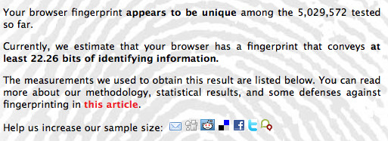
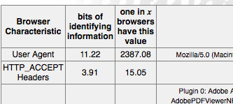
How unique is your Browser signature: https://panopticlick.eff.org/
17

